Slide 1

SDLC Using Agentic AI
Building an Adaptive AI Software Engineering Organization
Presented By:
Abhishek Raj (M.Tech Intern)
Guide:
M.B. Sai Charan (Scientist C)

Slide 2
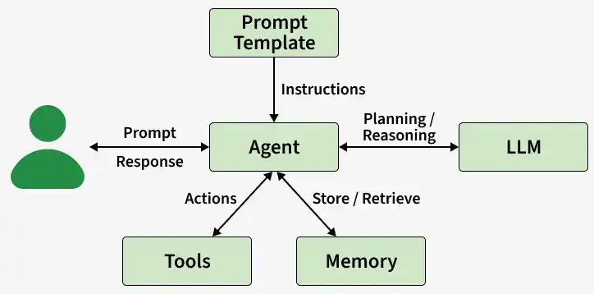

What is an AI Agent?
AI agents can encompass a wide range of functions beyond natural language processing including decision-making, problem-solving, interacting with external environments and performing actions.
AI agents solve complex tasks across enterprise applications, including software design, IT automation, code generation and conversational assistance.
They use the advanced natural language processing techniques of large language models (LLMs) to comprehend and respond to user inputs step-by-step and determine when to call on external tools. [17]
Agent = LLM + Memory + Prompt Template + Tools

Slide 3


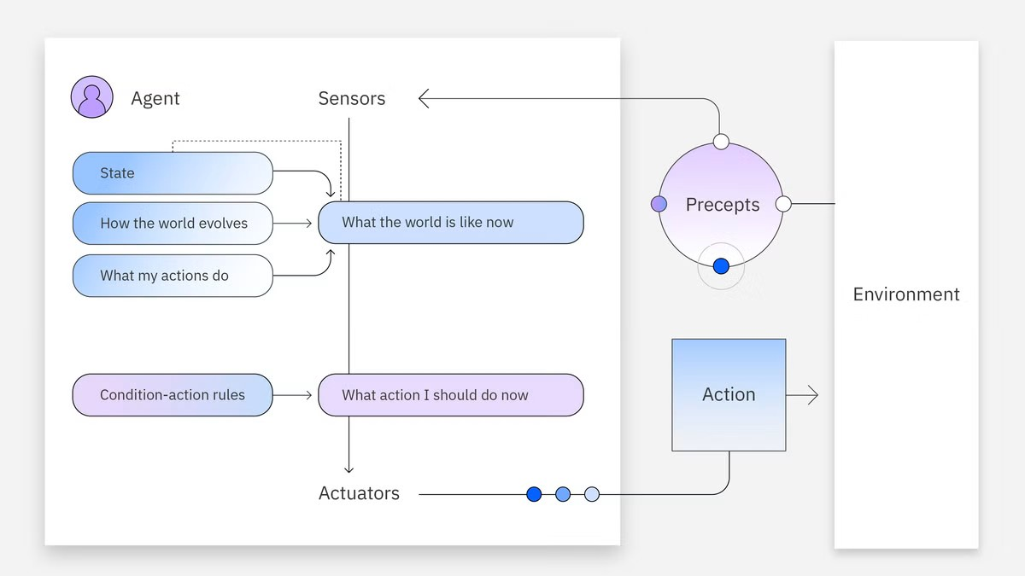
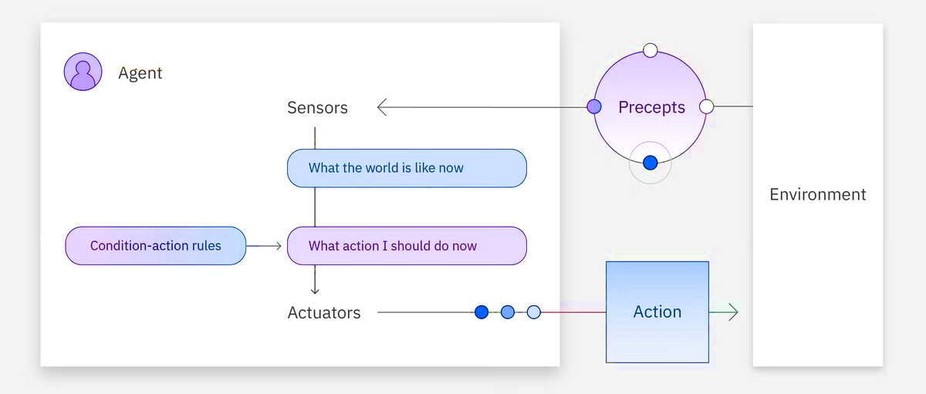


Types of AI Agents
Model-Based Agents
Model-based reflex agents use both their current perception and memory to maintain an internal model of the world. As the agent continues to receive new information, the model is updated. The agent’s actions depend on its model, reflexes, previous precepts and current state. [4]
Simple Reflex Agents
Simple reflex agents are the simplest agent form that grounds actions on perception. This agent does not hold any memory, nor does it interact with other agents if it is missing information. [4]
No memory capacity
EXAMPLES
Maintains internal state
EXAMPLES
Rule-based decisions
Handles partial observability
Fast but inflexible
Updates knowledge continuously

Slide 4


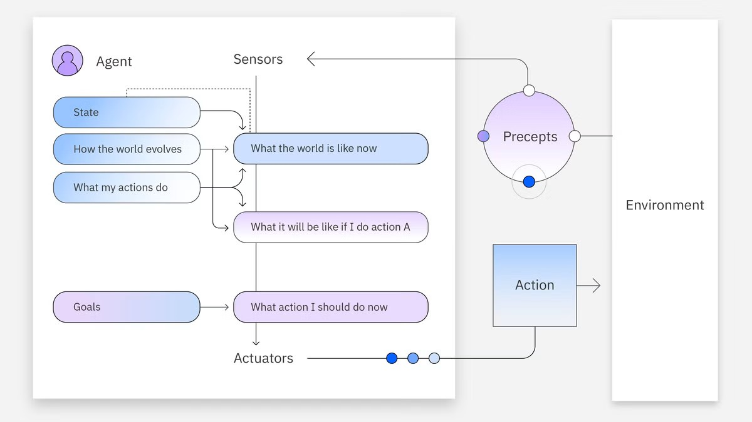
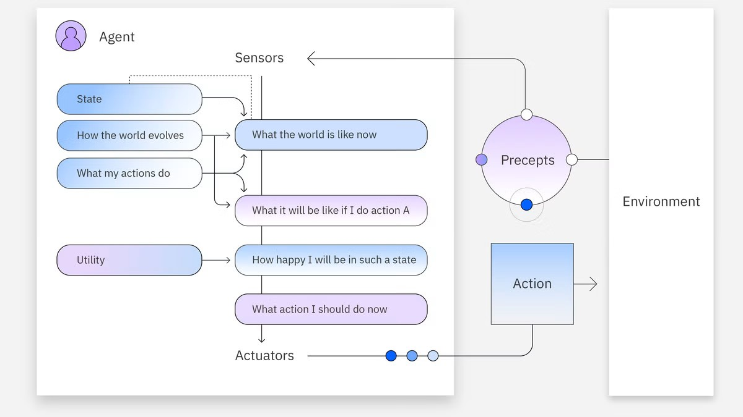

Types of AI Agents (Cont.)
Goal-Based Agents
Utility-Based Agents
Goal-based agents have an internal model of the world and also a goal or set of goals. These agents search for action sequences that reach their goal and plan these actions before acting on them. This search and planning improve their effectiveness when compared to simple and model-based reflex agents. [4]
Utility-Based Agents evaluate multiple possible actions using a utility function, selecting the option that maximizes overall performance and handles trade-offs efficiently. [4]
Goal-oriented approach
Decision optimization
EXAMPLES
EXAMPLES
Planning & search capabilities
Handles complex trade-offs
Navigation Systems
Evaluates possible actions
Maximizes expected reward/utility

Slide 5

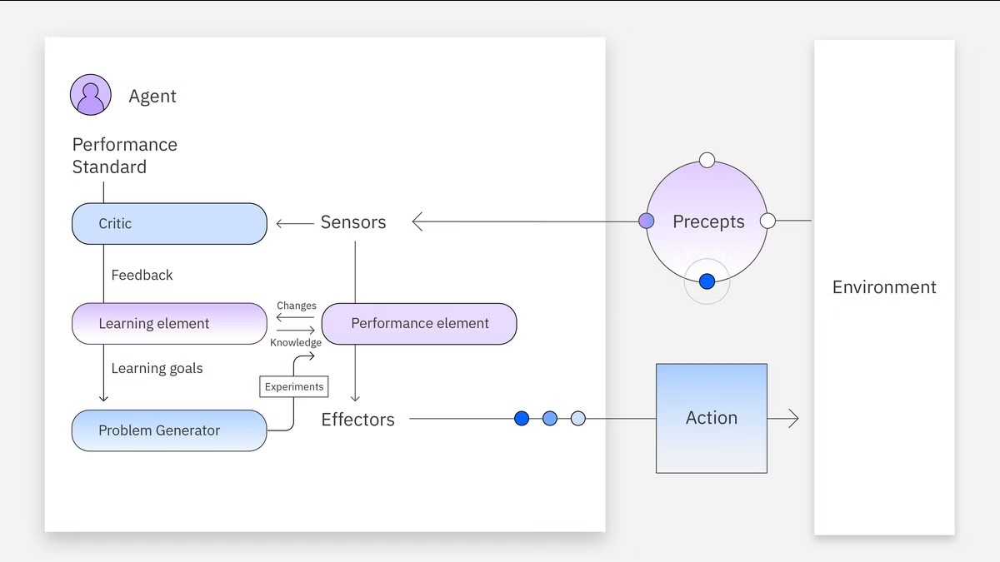
Types of AI Agents (Cont.)
Learning Agents
Learning agents hold the same capabilities as the other agent types but are unique in their ability to learn. New experiences are added to their initial knowledge base, which occurs autonomously. This learning enhances the agent’s ability to operate in unfamiliar environments. Learning agents might be utility or goal-based in their reasoning and are composed of four main elements:
Learning: This process improves the agent’s knowledge by learning from the environment through its precepts and sensors.
Critic: This component provides feedback to the agent on whether the quality of its responses meets the performance standard.
Performance: This element is responsible for selecting actions upon learning.
Problem generator: This module creates various proposals for actions to be taken. [4]
Self-improving over time
EXAMPLES
Learns directly from experience
Adapts to changing environments

Slide 6



AI Agent Architectures
Different patterns for designing agents based on how they reason, act, and collaborate.
1. ReAct (Reason & Act)
2. Sequential Workflow
It combines reasoning and action in a dynamic, iterative loop where a single agent observes the environment, formulates a plan, executes an action using available tools or APIs, and evaluates the resulting feedback to decide the next step. By constantly re-evaluating its context, the model can course-correct on the fly, retry failed tool calls, or adjust its strategy based on intermediate outputs. [6]
It arranges processing steps into a strict, deterministic assembly line where the structured output of one module directly feeds as the input to the next. Typical execution flows linearly through discrete stages: extracting raw data from a source, transforming and cleaning it into a structured schema, analysing key metrics, and generating a polished output. Because each phase has bounded boundaries, this architecture reduces latency and non-deterministic behaviour, making it ideal for standardized, step-by-step tasks
Observe
Reason
Take Action
Evaluate
Extract
Transform
Analyze
Generate
Perceive the environment
Decide what to do next
Use tools or APIs
Review result & feedback
Get data from source
Clean, format & structure
Compute insights
Create final output
Example Use Cases:
Q&A, Code generation & debugging
Example Use Cases:
Document processing pipeline, Report generation

Slide 7




AI Agent Architectures (Cont.)
Different patterns for designing agents based on how they reason, act, and collaborate.
3. Routing Architecture
4. Multi-Agent Swarm
The Routing Architecture acts as an intelligent traffic controller that uses a centralized supervisor or classification node to interpret user intent before delegating execution. Once the router identifies the nature of the input query, it dynamically dispatches the request to a dedicated specialized sub-agent.
This separation keeps individual agent prompts lightweight, context windows focused, and token costs optimized, making it a natural fit for multi-domain customer support systems and triage-heavy enterprise applications.
A Multi-Agent Swarm relies on a manager agent to orchestrate a ecosystem of domain-expert sub-agents working together toward a high-level goal. The manager breaks down complex user objectives into specific tasks and assigns them to specialized roles—such as a Coder for implementation, a Researcher for context gathering, and a Reviewer for quality assurance—who can debate, review each other's work, and iteratively refine deliverables. By enabling peer-level verification and specialized division of labour, swarms excel at tackling high-complexity, multi-layered domains
Specialized Agents
User Query
Router
Specialized Agents
Response
User Goal
Manager
Coder
Researcher
Reviewer
Final Output
Input / Request
Understand intent
Tech Support | Billing
Return best answer
Define objective
Plan & assign
Integrated result
Customer support automation
Example Use Cases:
Example Use Cases:
Software development teams, Threat analysis & support

Slide 8
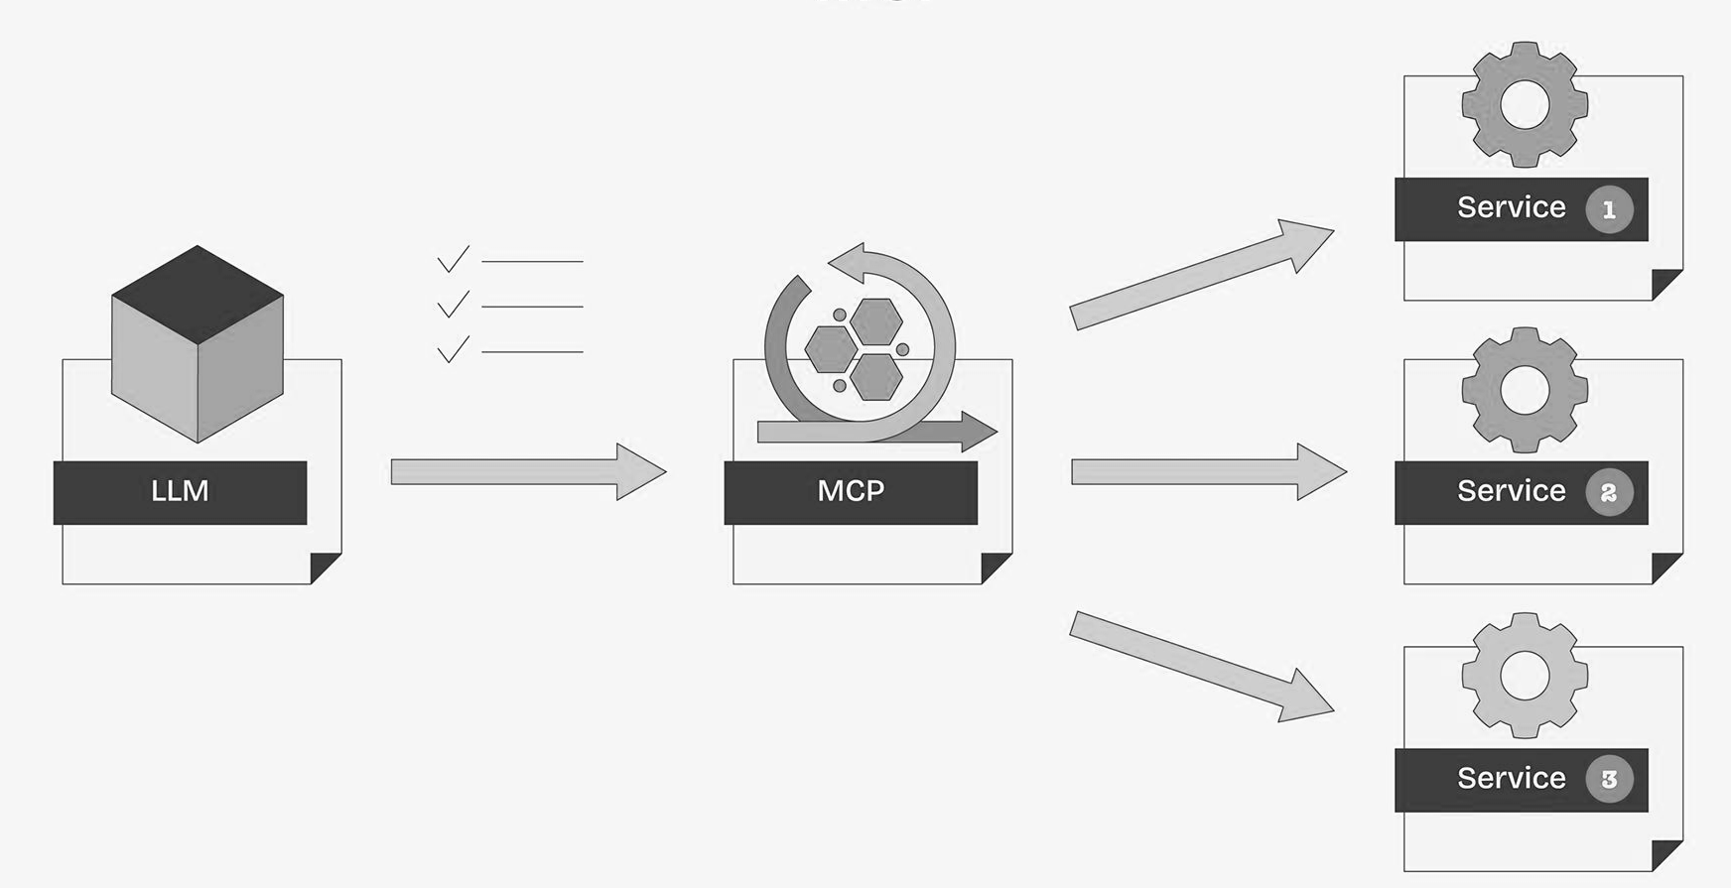
What is MCP & Why Do We Need It?
The Core Problem: LLM knowledge is frozen at training time & LLMs Agents cannot inherently interact with the outside world (real-time data, business systems, APIs).
The Solution (MCP): The Model Context Protocol is an open standard that enables developers to build secure, two-way connections between their data sources and AI-powered tools. The architecture is straightforward: developers can either expose their data through MCP servers or build AI applications (MCP clients) that connect to these servers [18]
Here is a simplified look at how MCP would handle this:
1. Discover Tools: AI realizes it needs external help and finds the database and email tools registered on MCP.
2. Fetch Data: AI requests the sales report via MCP; the database server fetches and returns the report.
3. Send Email: AI hands the report to the email tool, which sends it to the manager.
4. Confirm: AI tells you the task is finished. [18]

Slide 9
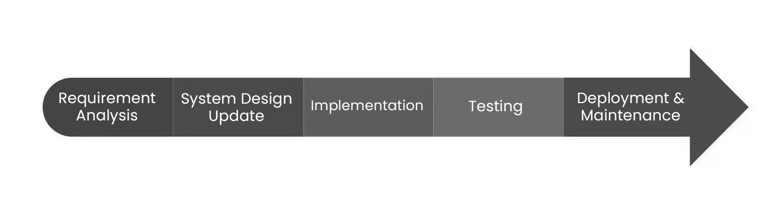
The Traditional SDLC
The Traditional Software Development Life Cycle (SDLC) is the structured framework that engineering teams follow to plan, design, build, test, and deploy software applications from initial concept.
This Manual SDLC execution creates severe friction—engineers waste most of their time on administrative handoffs, environment setups, regression testing, and ticketing overhead instead of writing core logic.[5]
So, Our Aim is to automate the Traditional SDLC with Agentic AI, which will replaces these static bottlenecks with continuous, self-healing pipelines that autonomously execute tests, patch build failures, flag vulnerabilities, and manage releases. This eliminates human error, compresses cycle times from months to hours, and frees development teams to focus on high-value architecture and innovation.

Slide 10
Beyond Code Generation: Agentic AI
Strategic Comparison: Conversational AI vs. Agentic Systems. [16]
Feature / Aspect | AI Chatbot | AI Agent
Primary Function | Simulates conversation, often using rule-based or scripted responses to assist with simple Q&A. | Autonomous, goal-driven, and capable of reasoning to assist with multi-step tasks.
Personalization | Minimal personalization. | High personalization; adapts to user preferences over time.
Learning Ability | Limited learning ability. | Learns from user behavior and ongoing interactions.
Context Awareness | Low context awareness; struggles with complex tasks and context shifts. | High context awareness; handles complex, multi-step execution.
Operation Style | Provides passive, conversational assistance. | Provides proactive support to plan, create, and execute tasks.
Best Used For | Quick answers and basic customer service queries. | Complex problem-solving, everyday planning, and managing continuous tasks.

Slide 11
Agentic Frameworks
Framework | Execution Model | Core Strengths | Key Limitations | Ideal Use Cases | Offline / Local Capability
LangChain [7] | Chained Prompting & Tools | Rich toolset, extensive RAG ecosystem, vast API integrations | Workflow complexity at scale, abstractions can hide errors | General LLM applications, retrieval-augmented generation | Excellent: Natively connects to local LLMs (Ollama, Llama.cpp) and local vector stores (Chroma).
LangGraph [8] | Stateful Graph Orchestration | Cycles and loops, robust state persistence, time-travel debugging | Steeper learning curve, excessive setup for simple tasks | Production-grade multi-agent systems, human-in-the-loop control | Excellent: Inherits LangChain's local capabilities; operates entirely offline with self-hosted models.
CrewAI [9] | Role-based Team Collaboration | Easy setup, intuitive agent personas, automatic task delegation | Limited dynamic branching and complex workflow flow control | Autonomous research pipelines, content creation, structured teams | Strong: Explicitly supports local execution by binding agents to local endpoints via Ollama or LiteLLM.
OpenAI Agents SDK [10] | Lightweight Handoffs & Guardrails | Minimal abstractions, built-in tracing, standardized routing primitives | Lacks built-in persistent long-term memory or native graph structures | Rapid deployment of production agents, voice pipelines, clear delegation | Very Good: Provider-agnostic design allows it to run offline by routing to local models via the Chat Completions API.

Slide 12







Proposed Architecture: Modular Pipeline
A modular pipeline with integrated Human-in-the-Loop (HITL) governance gates to ensure enterprise safety.
Requirement Engineering
Planning
HITL Approval
Continuous Loop
7. Monitoring & Learning: Consumes production logs, metrics, and user feedback to detect errors and optimize prompts.
Architecture & Design
HITL Approval
Development
8. Organizational Memory: Captures all requirements,
code, reviews, and bug fixes into a Knowledge Graph for cross-sprint learning.
Verification (Quality Assurance (Testing)/Security)
HITL Approval
Deployment
HITL Approval

Slide 13
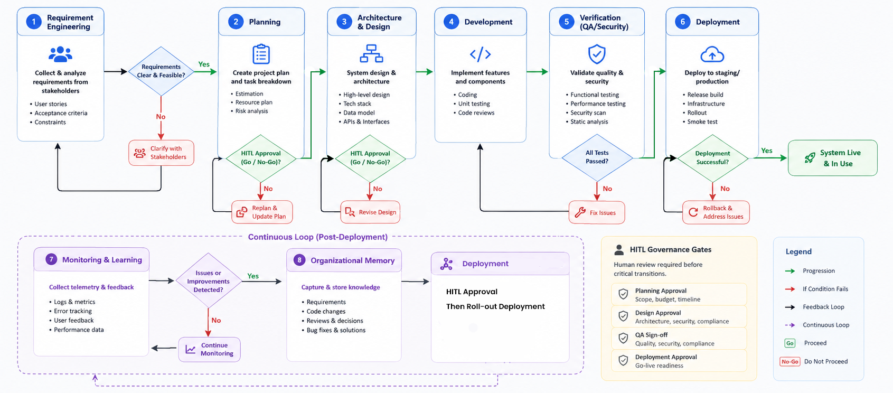
Proposed Architecture: Modular Pipeline

Slide 14
Identifying the Gap
While highly capable, existing autonomous systems index heavily on code generation, lacking end-to-end SDLC orchestration and organizational memory.
System | Requirements | Design | Coding | Testing | Deployment
Devin / OpenHands [14][15] | Partial | Partial | Yes | Yes | Partial
MetaGPT / ChatDev [11][12] | Yes | Yes | Yes | Partial | No
SWE-Agent [13] | No | No | Yes | Yes | No
Proposed System | Yes | Yes | Yes | Yes | Yes

Slide 15


Core Innovation: Adaptive Team Generation
Traditional: Fixed Agents
Proposed: Dynamic Generation
Standard agentic systems rely on rigid, hardcoded workflows (e.g., always Planner → Developer → Tester).
The Orchestrator analyzes project complexity, risk, and size before execution to spawn agents on-the-fly.
■
Inefficient for small tasks (over-engineered).
■
Small Script: Spawns Planner + Developer.
■
Lacks specialized roles (Security, DevOps) for complex enterprise apps. [1]
■
Enterprise App: Spawns Architect, Backend, Frontend, Security, QA, DevOps.
■
Agents are retired when tasks complete, saving compute.

Slide 16






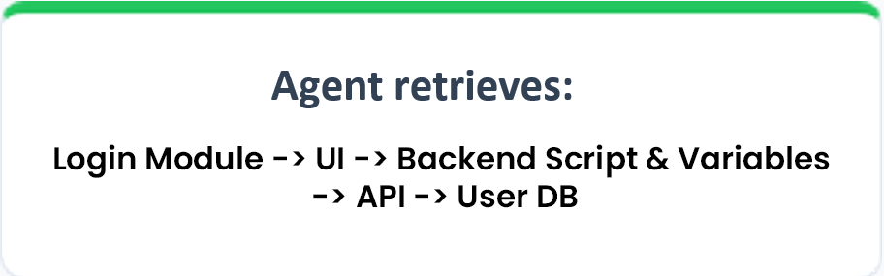
Core Innovation: Hierarchical Software Knowledge Graph (HSKG)
Project Graph
Context-Aware
Beyond Traditional Memory:
A Context-Aware Project Memory
Project
Instead of:
├
Authentication Login, Register
The Problem: Current AI agents retrieve entire repositories or large documents, resulting in high token consumption and irrelevant context. [1]
├
Inventory Product, Stock
└──
Invoice Create, Payment
Our Solution: Our proposed HSKG stores the software project as a hierarchical graph, enabling agents to retrieve only the smallest relevant subgraph required for a task.
Purpose
Represents the complete SDLC structure
Maintains hierarchy between project components
Enables modular navigation
Benefits
Minimal context
Lower token usage
Faster reasoning
Better accuracy
Reduced hallucination

Slide 17
Local Offline Execution Strategy
Deploying via offline models ensures data privacy. Model selection is based on VRAM footprint, Training data freshness, Suitable for Agentic Operations.
Model (4-bit Quant) | Recommended Hardware (VRAM) | Knowledge Cutoff | Agent Capability | Best Use Case
Gemma 4 4B | Laptop / iGPU (~5 GB) | Early 2026 | ⭐⭐⭐ | Basic assistants, RAG, lightweight offline agents
Gemma 4 12B | RTX 4070 (8–10 GB) | Mid 2026 | ⭐⭐⭐⭐ | General-purpose AI agents with good reasoning & tool use
Mistral Small 3.2 (24B) | RTX 4090 (16 GB) | Mid 2025 | ⭐⭐⭐⭐⭐ | Enterprise agents, multi-tool workflows, planning
Qwen3-Coder 32B | Workstation / Mac M-Series (20–22 GB) | Mid 2025 | ⭐⭐⭐⭐⭐ | Coding agents, debugging, software engineering
Llama 3.3 70B | Multi-GPU / High-End Server (48+ GB) | Late 2023* | ⭐⭐⭐⭐⭐ | Research, complex planning, multi-agent orchestration
Source: Compiled from official model documentation and validated using publicly available implementation benchmarks and deployment experiences.

Slide 18
Conclusion
We are proposing an Autonomous Software Development Lifecycle (A-SDLC) framework that transforms traditional software engineering into an AI-Orchestrated Software Engineering Organization.
Instead of isolated coding assistants, the system coordinates multiple specialized AI agents across the complete SDLC—from requirements engineering to continuous monitoring and learning.
"
Expected Outcomes
Reduced context size and token consumption
Faster and more accurate software development
Improved traceability across the SDLC
Persistent engineering knowledge

Slide 19
References
Research Papers
Articles & Official Documentations
[1] He, J., Treude, C., & Lo, D. (2025). LLM-Based Multi-Agent Systems for Software Engineering: Literature Review, Vision... ACM TOSEM.
[7] LangChain Documentation.
[8] LangGraph Documentation.
[2] Apostolou, S. A., et al. (2026). Assistance to Autonomy: A Systematic Literature Review of Agentic AI across the SDLC. arXiv.
[9] CrewAI Documentation.
[3] Agentic AI in the Software Development Lifecycle: Architecture, Empirical Evidence... (2026). arXiv.
[10] OpenAI Agents SDK Documentation.
[11] Hong, S., et al. (2024). MetaGPT: Meta Programming for Multi-Agent Collaborative Framework.
[4] Veselka Sasheva Petrova-Dimitrova, “Classifications of intelligence agents and their applications,” Fundamental sciences and applications, Vol. 28, No. 1, 2022.
[12] Qian, C., et al. (2024). ChatDev: Communicative Agents for Software Development.
[5] Sommerville, I. Software Engineering (10th Edition).
[13] Yang, J., et al. (2024). SWE-Agent: Agent-Computer Interfaces Enable Automated SE.
[6] Yao, S., Zhao, J., Yu, D., et al. (2022). ReAct: Synergizing Reasoning and Acting in Language Models. arXiv. https://doi.org/10.48550/arxiv.2210.03629
[14] OpenHands Project.
[15] Cognition AI – Devin: AI Software Engineer.
[16] Microsoft-copilot/for-individuals/do-more-with-ai/general-ai/understanding-ai-agents-vs-chatbots?
[17] IBM: https://www.ibm.com/think/topics/ai-agents
[18] Google Cloud: cloud.google.com/discover/what-is-model-context-protocol

Slide 20
"
Thank You

